Slide 1
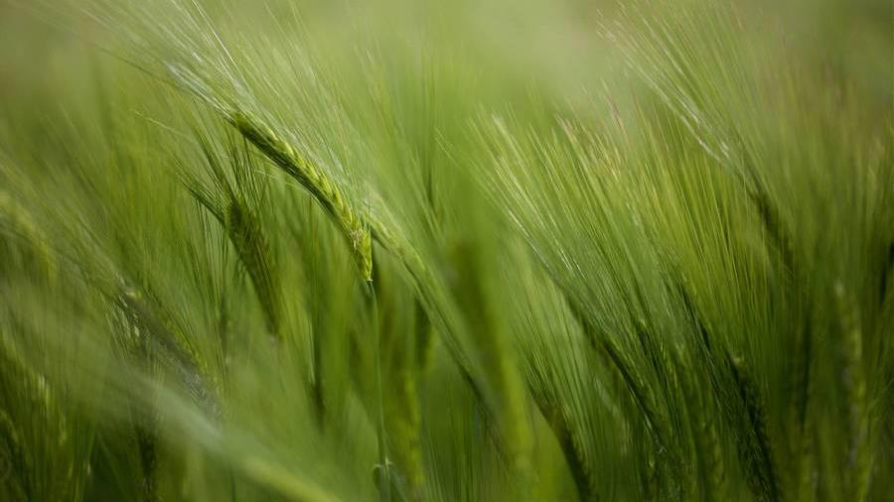
MSA Phase 3 Presentation
Frank Situ​​

Slide 2
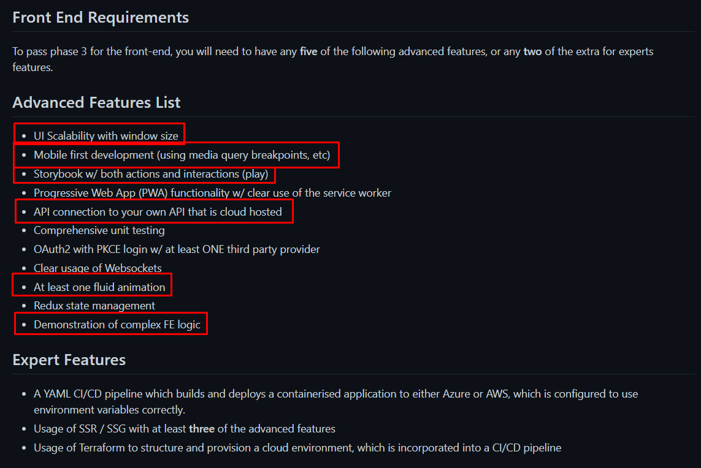
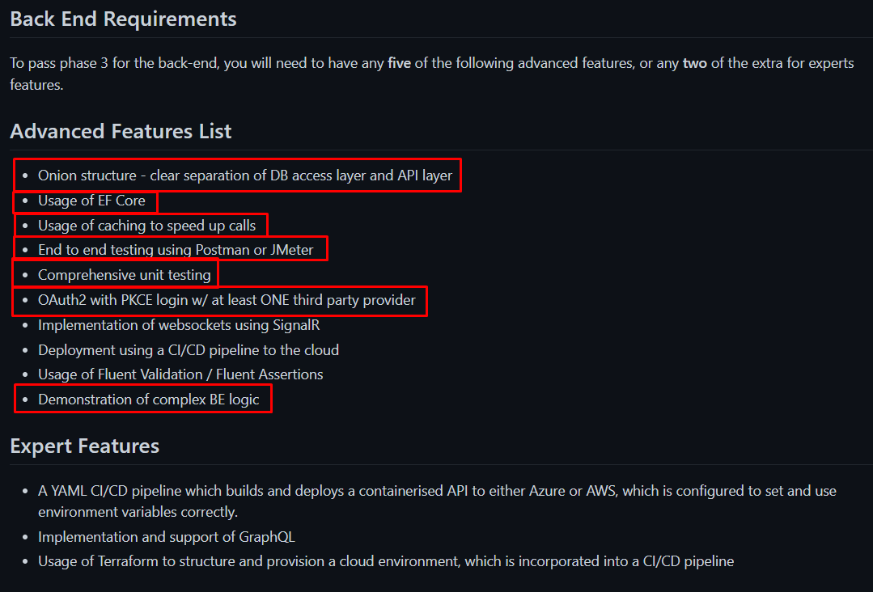
Frontend (5 Mins)
Backend (5 Mins)
Typescript
React
MUI library
+ Adv features
Java Spring Framework (Equiv to C# .net framework)
H2 Database (Lightweight DB)
Maven Project
+ Adv features

Slide 3
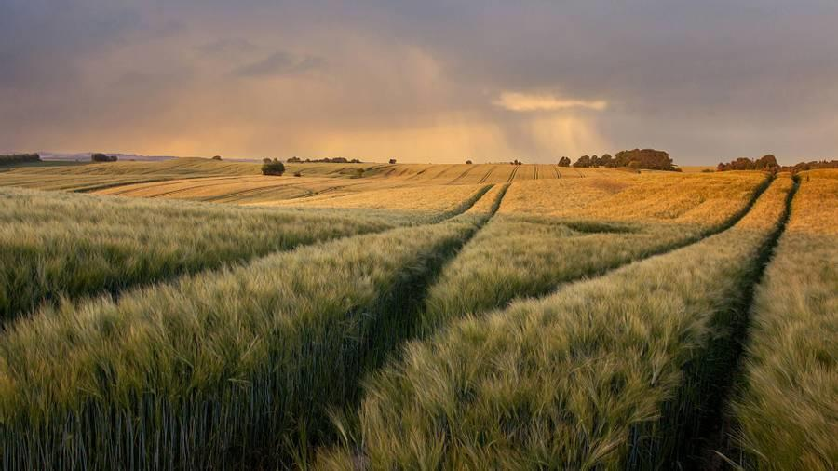
Backend

Slide 4
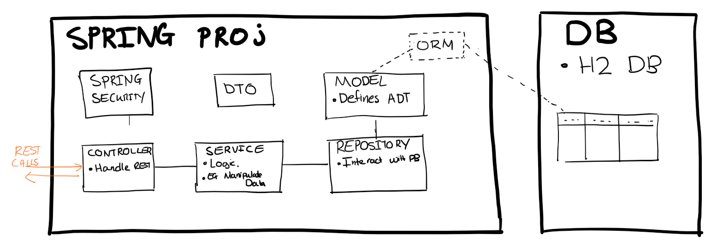
backend features
Requirement #1: Onion Structure.
The backend is split into the following layers
Requirement #2: Usage of EF Core
Equivalent is Spring ORM and Spring JPA.
Requirement #3: Demonstration of complex BE logic
Usage of relational DB
Usage of DTO to items from two tables with one REST call
Usage of DTO to hide certain attributes
Usage of Paging.
Usage of Sorting
Usage of searching
Notes:
EF Core: Equiv is Spring ORM and Spring JPA
Enables me to work with a database using POJO (Plain old java objects)
Eliminates the need for most of the data-access code that typically needs to be written.

Slide 5
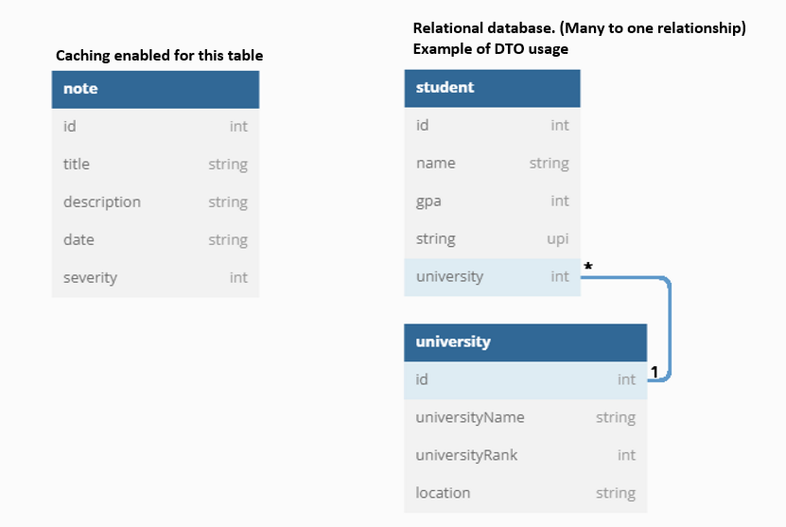
#3 Demonstration of complex BE logic in more detail
Usage of relational DB
Usage of DTO to get related items from two tables with one REST call.
Usage of DTO to hide certain attributes
Usage of Paging.
Usage of sorting
Usage of searching
Feature | Demonstrated by
(1) | Student and Uni table. Many to one relationship.
(2), (3) | (Show in person example)
(4) (5) | Paging when getting all student rows. Also sorting param there
(6) | Shown in /student/upi endpoint
Notes:
Feature 1. Show in code the relationship
Feature 2/3 Show using dto_example endpoint
Feature 4/5 Show in get all students
Feature 6 show in /student/upi endpoint. Search with all upis containing “pi”

Slide 6
backend features
Requirement #1: Onion Structure.
The backend is split into the following layers
Requirement #2: Usage of EF Core
Equivalent is Spring ORM and Spring JPA.
Requirement #3: Demonstration of complex BE logic
Usage of relational DB
Usage of DTO to items from two tables with one REST call
Usage of DTO to hide certain attributes
Usage of Paging.
Usage of sorting
Requirement #4: Caching
Show example of the Note table.
Requirement #5: OAuth2
Github OAuth2.
Requirement #6: Junit Testing
Mocking and Junit.
Show example
Requirement #7: Jmeter Test
Show example with caching on Note table.
Notes:
Caching is shown. Show backend note service. We can prove we have caching by every time we fetch data from the db we mock a slow db with pausing for 4 secs. Show example
Oauth2. Go incog and get the login page.
Junit testing. Goto tests and run it
Jmeter Test. Goto Jmeter and show tests

Slide 7
Frontend

Slide 8
Frontend features
Requirement #1: UI scalability with window size
Shown through random resizing of window
Requirement #2: Mobile First development
Shown through Mobile view Chrome using multiple mobile devices.
Requirement #3: Storybook
Shown through example
Requirement #4: API connection to own API that cloud hosted
Shown through Heroku dashboard of API that is hosted.
Shown through App that connects to the API
https://git.heroku.com/msa-notes-backend.git (May take awhile when first loading as server boots up, reasoning: Free plan)
Requirement #5: Fluid animation
Shown through example
Requirement #6: Complex FE logic.
Shown through example. App split into several layers, components
Usage of react hooks, useStates.
Usage of TS types

Slide 9
The End Thank you!

